Slide 1
Subtle Signs
of
Scribal Intent
in the
Voynich Manuscript
Andrew Steckley, PhD
Noah Steckley
Histocrypt 2024, June 25-27, 2024, Oxford/Bletchley Park, UK

Slide 2
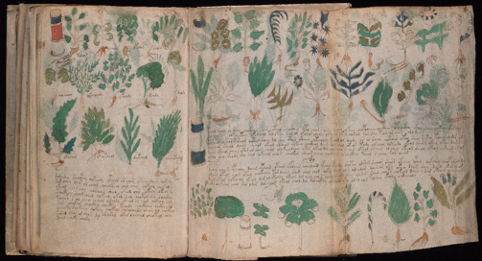
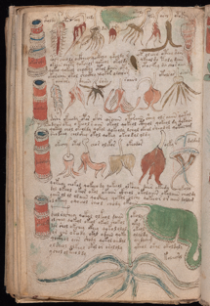
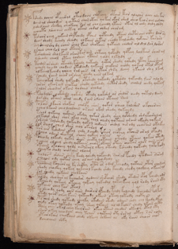
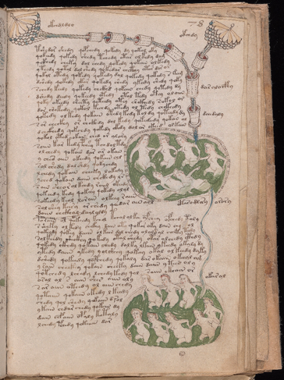
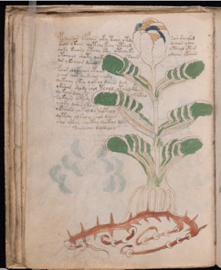
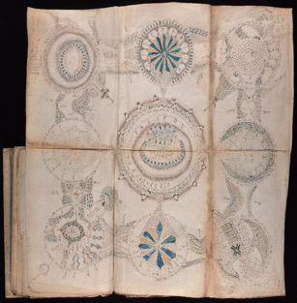
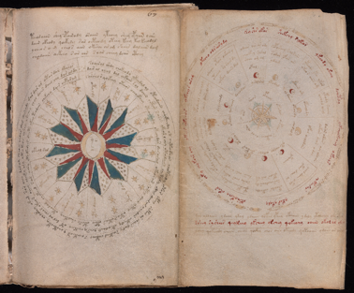
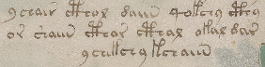
“An Elegant Enigma”
Notes:
Many of you know of the Voynich Manuscript which was discovered by Wilfred Voynich around 1912
It contains over 200 folio pages with all kinds of strange drawings of plants, and astrological diagrams, and naked women in green water.
And it has this handwritten script in an unknown language that is not found anywhere else.

Slide 3
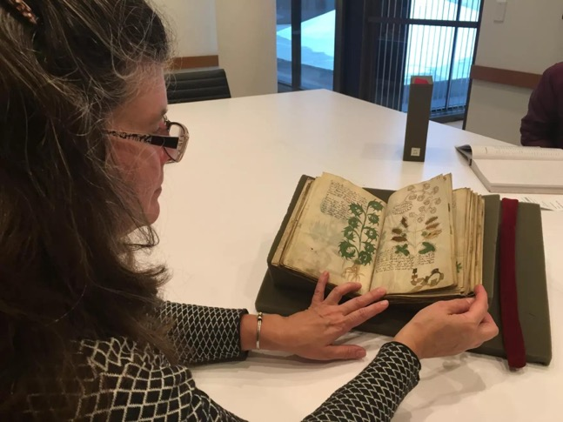
Many Theories, Few Facts
Who ⇒
Guesswork
weak theories
When ⇒
~15th century vellum
Where ⇒ provenance?
Why ⇒ guesswork?
What it says ⇒ least known
Notes:
We know very little about the manuscript with any certainty
We don’t know who wrote it
The vellum was carbon dated to the early 15 century, but we don’t know when it was actually written
Its provenance before 1912 is very uncertain
We don’t know why it was written – whether it’s a private journal or a medical text book or what.
And we don’t know what the script says – or even if it says anything at all

Slide 4
The Paramount Question
Does the Voynichese script contain meaningful content that can be deciphered…
or merely the appearance of such content?
Knowing if it contains meaningful content would significantly sharpen and enhance the effectiveness of ongoing research efforts
Notes:
So to me the paramount question is…
Does the script convey meaningful content
Or is it just a work of art intended to appear like it has real content
Knowing that could guide further research – I for one do not want to waste time trying to decipher the script without having more confidence that it is in fact decipherable

Slide 5
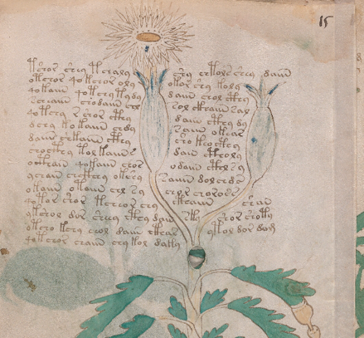
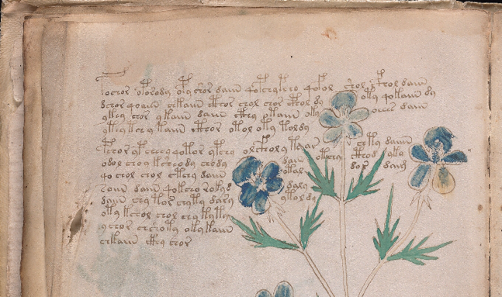
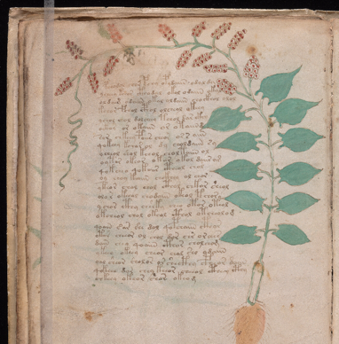
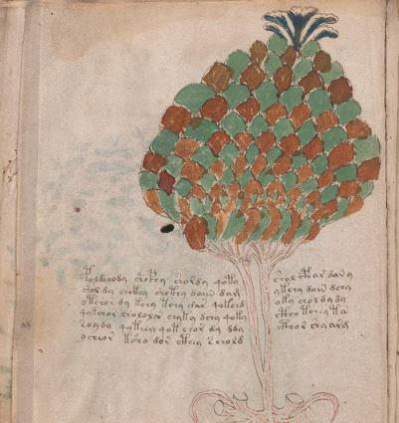
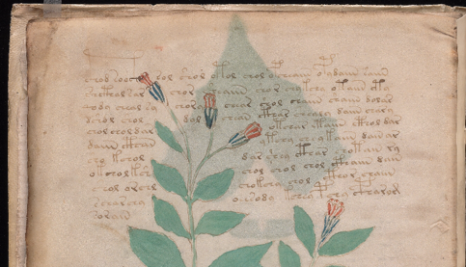
Script Conformity to Drawings
Notes:
The impetus for this current study was a particular feature of the script found throughout the manuscript
The handwritten “Voynichese” script conforms tightly to the shapes of drawn illustrations
This is the case for all of the larger drawings of plants that are found in the manuscript

Slide 6
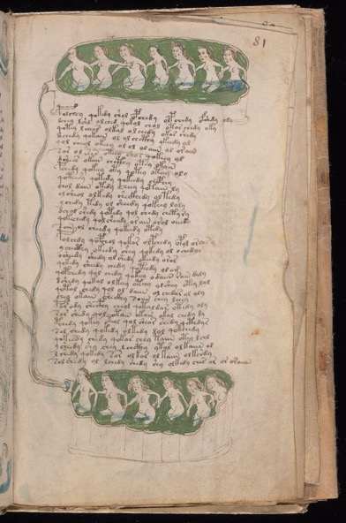
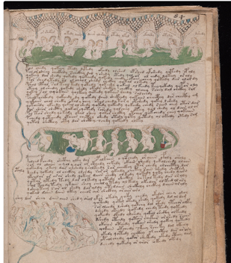
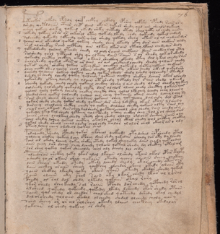
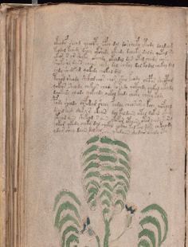
One Notable Exception
f81r
Notes:
All of the paragraph script seems to adhere to left and right margins
There is one noticeable exception to that though
Folio f81r show an irregular right-hand margins – almost as if the script was intended to be written around a drawing that isn’t present.
Perhaps this page represents s distinctly different form of content – like a poem.

Slide 7
What Did the Scribe(s) Intend?
Meaningful content or Aesthetic nonsense?
Does it represent a natural language?
Can it be deciphered into meaningful content?
Does it contain the signatures of “gibberish”?
Notes:
So what did the Scribe intend?
Was they trying to convey meaningful content
Or were they more concerned with the aesthetic appearance and so were just making up words to fill the spaces tightly around the drawings.

Slide 8
Present Study
Study Corpus
Token Cohorts
Token Length Analysis
Token Propensity Analysis
Conclusions
Possible Explanations
Notes:
I’ll try to cover briefly the basic work and findings.
Some of the findings are not surprising, but a couple of them are not what we would expect.
We’ve done some subsequent analyses to look at possible explanations for those, but I don’t expect to. have time to get into those.
But would be happy to discuss later with anyone that’s interested.

Slide 9
Study Corpus
Notes:
So first we wanted to select a specific subset of the manuscript as a study corpus for our analyses

Slide 10
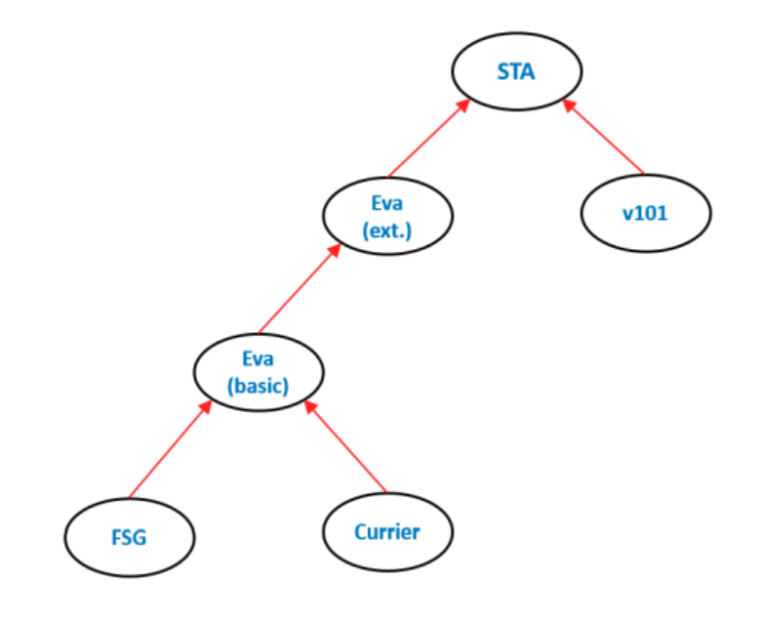
Transliterations
Zandbergen and Landini using their EVA (Extensible Voynich Alphabet)
Differentiates glyphs and tokens by location in paragraphs, non-paragraphs, isolated labels
Indicates glyphs whose identification is uncertain
Indicates if a token is adjacent to drawings and in terminal positions of lines
Notes:
There have been several transliteration alphabets defined by various people
We chose to use the transliteration of Zanbergen and Landini which used their Extensible Voynich Alphabet or EVA
This one was good for our purposes because it
Differentiates the glyphs and tokens that are in paragraphs vs isolated line or labels
Indicates whether a glyph is uncertain as to which glyph the Scribe was intending to write
Importantly, it identifies tokens with respect to location – wheteher they are relative to paragraphs and lines, but also whether they are adjacent to drawing intrusions

Slide 11
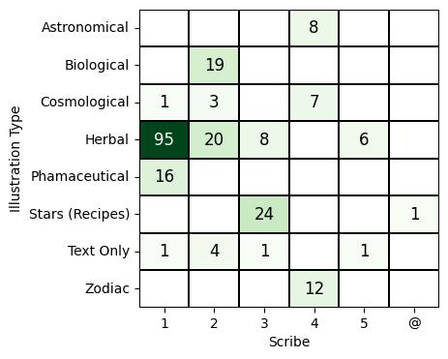
Selected Content
Limited to a single topic and a single scribe.
A homogeneous corpus helps avoid the obscuring of significant attributes by multiple contributory factors.
Supports independent and explicit consideration as to whether conclusions, once drawn, likely apply to the rest of the manuscript
Notes:
Now the manuscript is believed to have several different topic section based on the types of drawings and the layout of the handwriting
The Herbal section refers to those folio pages that have large plant drawing on them and that’s what we were interested in
It is also believed that the manuscript was written by several scribes.
Lisa Fagin Davis has studied the script and the variations in glyphs and strokes and has proposed 5 individual scribes and which folio pages they wrote
So we chose to limit the study to the 95 folio pages in the herbal section written by what she has called Scribe 1

Slide 12
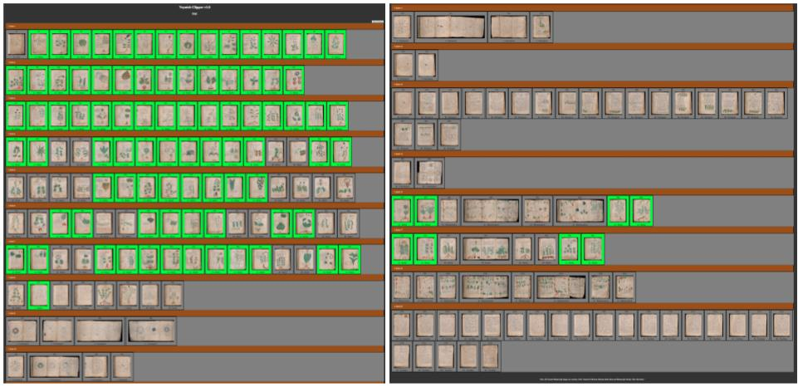
Selected Content
Notes:
Here, the 95 folios included in the study corpus are shown highlight from the total 216 folios
So we are looking at just. under half of the folio pages.
The entire manuscript contains nearly 40,000 separate word tokens, but most of them are on the other folios.
The 95 folios used contain about 7 or 8 thousand of the tokens

Slide 13
Token Cohorts
Notes:
Now we took all the tokens on those 95 folios and put them into separate groups or cohorts.

Slide 14
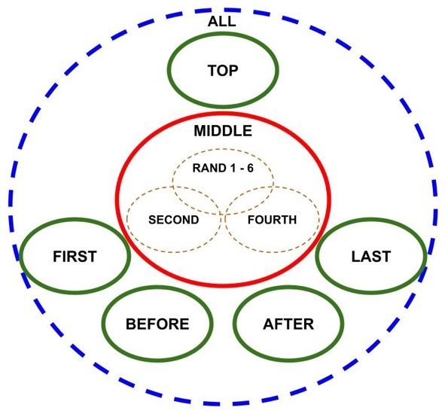
Mutually Exclusive Subject Cohorts
Notes:
The main cohort is all those tokens that occur in the middle of the paragraphs. This is the largest cohort and provided the main reference cohort against with all the others are compared.
Then we looked at 5 other positions and formed cohorts for each one.
The TOP cohort refers to all tokens that occur in the top lines of paragraphs,
The FIRST cohort has the tokens at the beginnings of lines, the LAST are those at the end of lines
The BEFORE has those immediately to the left of a drawing intrusion and the AFTER has those immediately to the right of one.
These green cohorts provided our five subject cohorts
And the red MIDDLE cohort provided the reference cohort.
We also formed several. other cohorts by drawing subsets from the reference cohort. These were used to provide additional validations

Slide 15
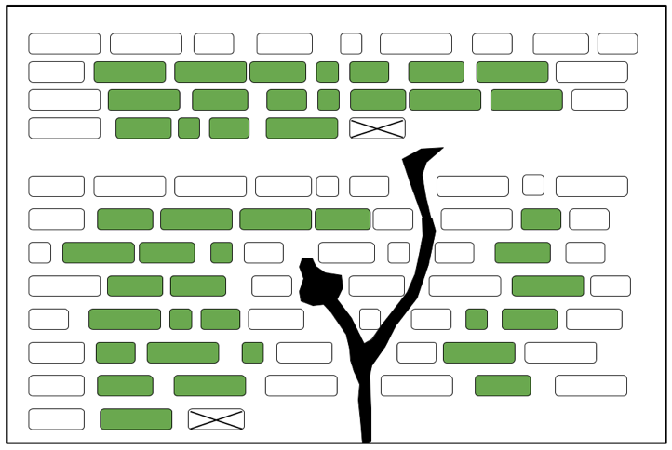
Separate Token Cohorts
MIDDLE
Notes:
This shows a typical page with two paragraphs of text and a drawing in the middle of the seconed paragraph.
The green icons are the tokens that would be in the cohort leballed MIDDLE
This represents a page with two paragraphs of tokens and a drawing that is within the second one.
The MIDDLE tokens are all in the interior of the paragraphs
The TOP are in the top lines,
The FIRST are first on each line
Note that if a token could be interpreted as being in more than one of these cohorts, then it was not included in either.
For example, the first token in a paragraph, or. the token in the middle of the drawing that falls both before a drawing intrusion and after another one

Slide 16
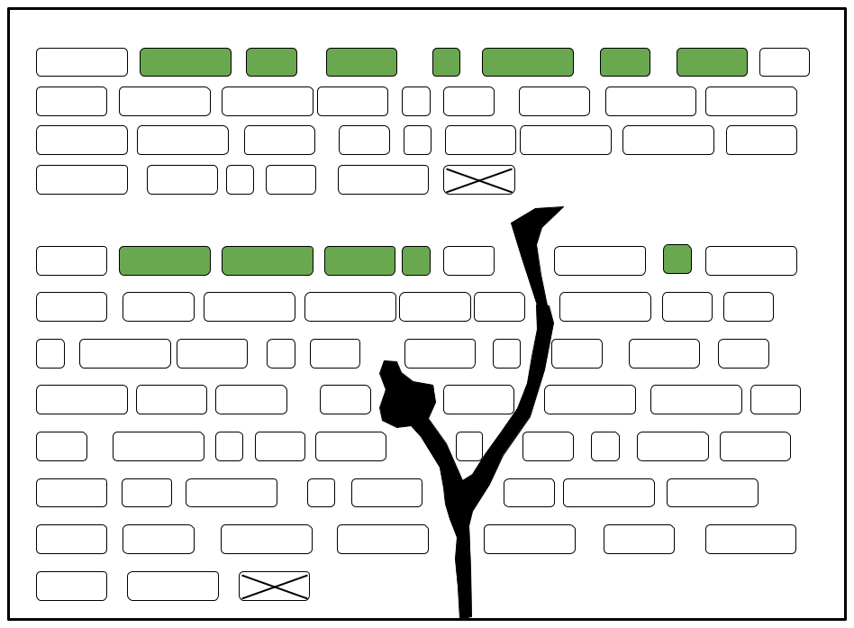
Separate Token Cohorts
TOP

Slide 17
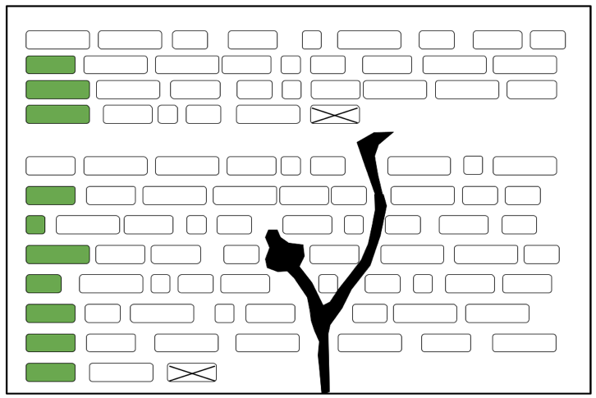
Separate Token Cohorts
FIRST

Slide 18
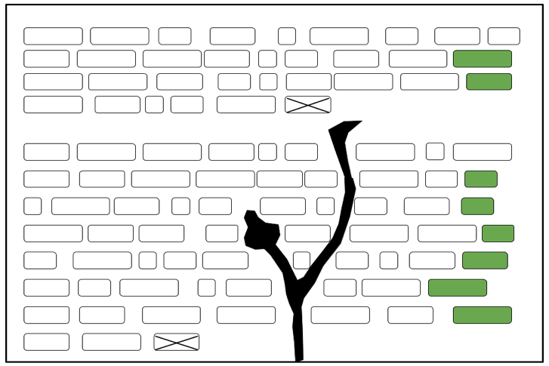
Separate Token Cohorts
LAST

Slide 19
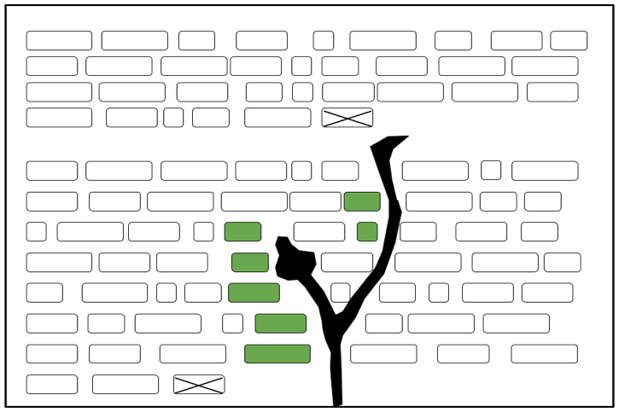
Separate Token Cohorts
BEFORE

Slide 20
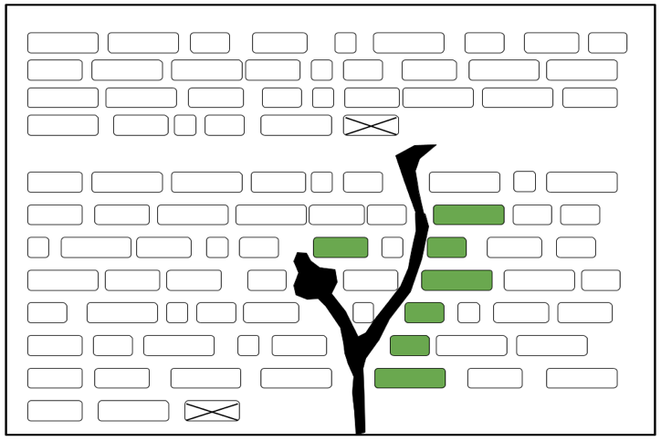
Separate Token Cohorts
AFTER

Slide 21
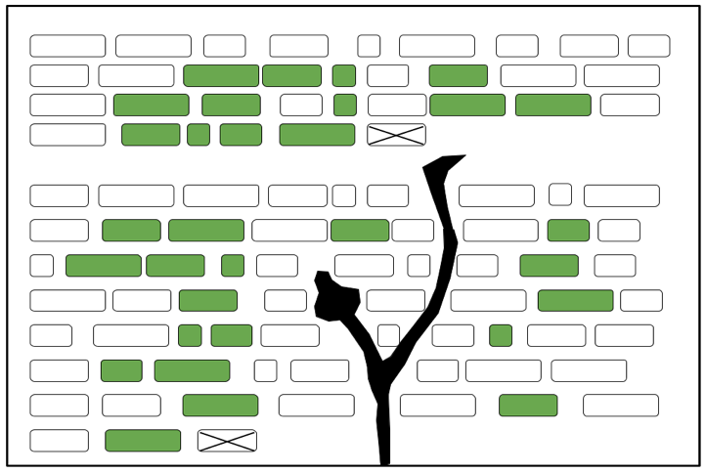
Separate Token Cohorts
RAND1

Slide 22
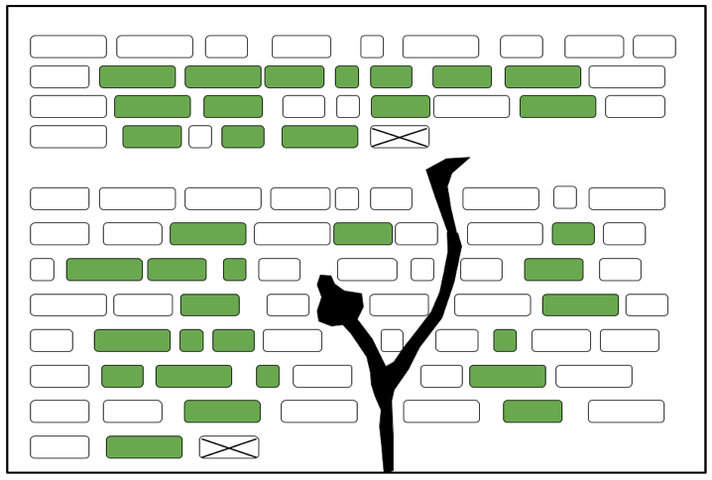
Separate Token Cohorts
RAND2

Slide 23
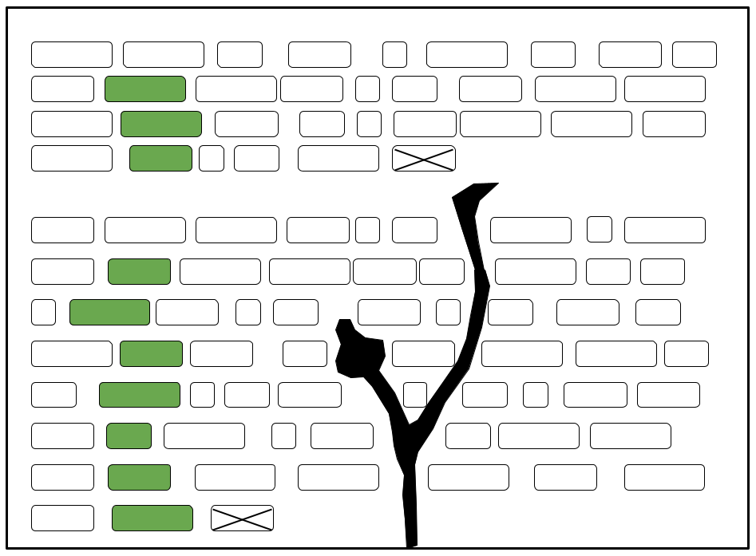
Separate Token Cohorts
SECOND

Slide 24
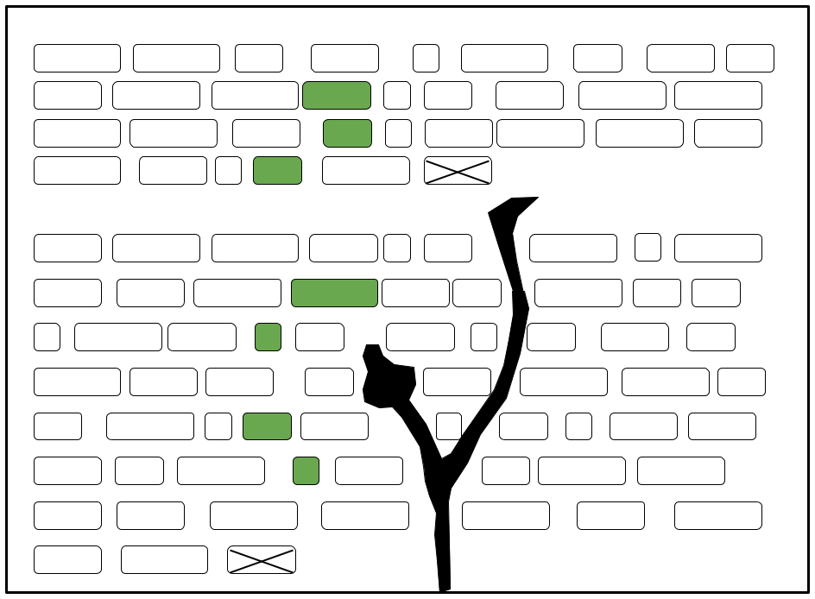
Separate Token Cohorts
FOURTH

Slide 25
Token Length Analysis
Notes:
In the first analysis, we looked at the distribution of token lengths within each cohort.
The length of a token was defined as the number of token it contained

Slide 26
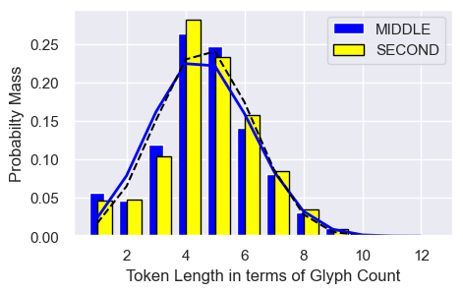
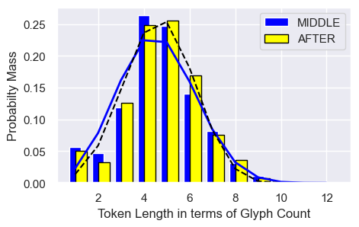
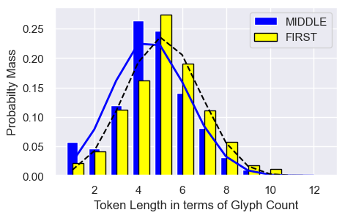
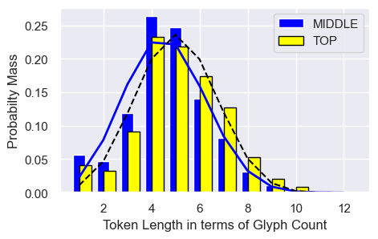
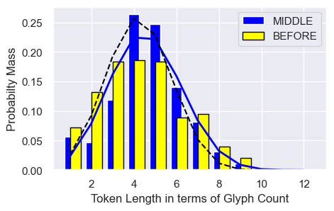
Differences in Length Distributions
Notes:
When we compare the distributions of token length for different pairs of cohorts, we can see that there are some difference between them but those differences aren’t dramatic
They could be due to random sampling effects.

Slide 27
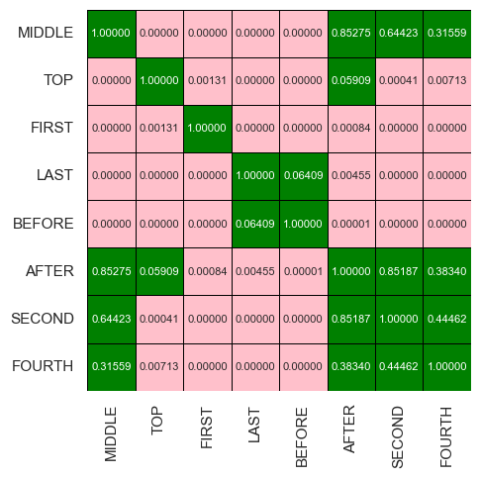
Token Lengths
Chi-Squared Test of Independence
The distributions of token length differs depending on position
The differences are statistically significant
Notes:
To determine wether the differences are significant, we did a Chi-Squared test on each pair of cohorts.
This give us, in each case, the probability that the differences between the distributions could be explained by random sampling effects.
The alternative implied to that is that the different token length distributions are due to some different underlying mechanisms at work.
This matrix shows the results of that.
The green cells indicate where the pair of cohorts are similar enough that the differences could be due to random sampling
The pink cells indicate where that is very likely and so thre is likely some. underlying mechanism driving the difference
The paper discusses this matrix in more detail, but the gist is that most of the five subject cohorts show statistically significant differences in token length distributions from each other.
as opposed to actually representing the difference bt distributions that are different for each cohort due to some underlying mechanism For the first of those analysis we compared the token length distributions using a Chi-Squared test of independence
This gives a measure of the probability that the observed differences between two distributions could be due to sampling variations as opposed to some underlying causal mechanism
The paper explains these several comparisons between cohorts in detail, but the gist of it is that the five subject cohorts exhibit distinctly different distributions of token length
And those differences are statistically significant – they are not simply the differences one would expect by different samples taken from the same underlying distribution.

Slide 28
Token Propensity Analysis
Notes:
The second analysis was aimed at determining if there are particular tokens that have a propensity to occur far more often in a particular position – or far less often – than we would expect based on the reference corpus.

Slide 29
Token Positional Propensities
One-tailed Binomial Test
Exact test of statistical significance of the deviation of an observed count from and expected count
Bayes Factor
Quantifies the strength of evidence in favor of one hypothesis over another
p-value < 0.01
AND
Bayes Factor > 150 ⇒ log(BF) > 5
⇒
Token has a
“tilted propensity”
Notes:
For this we looked one-by-one at each unique token that occurred in the reference cohort and determined if it occurred more often or less often than expected in each of the subject cohort.
To determine if the difference was significant (as opposed to being explainable by random sampling effects), we applied to different tests of significance
One using a frequentist approach with a p-value, and one using a Bayesian approach
And then we required that the token pass BOTH of the tests in which case we considered it to have a propensity to be used or not used more than expected.

Slide 30
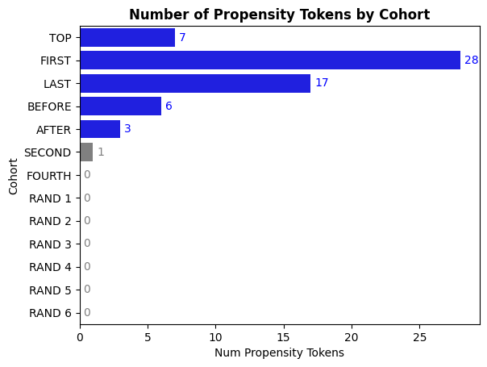
Numbers of Tokens with “Tilted” Propensities
Several tokens in each subject cohort had observed counts extremely different than expected
Notes:
What we found was that there were tokens showing a significant tilt in propensity in all five of the subject cohorts
But there were essentially none found for the validation cohorts – which we would expect since most of those do indeed represent a common underlying cohort

Slide 31
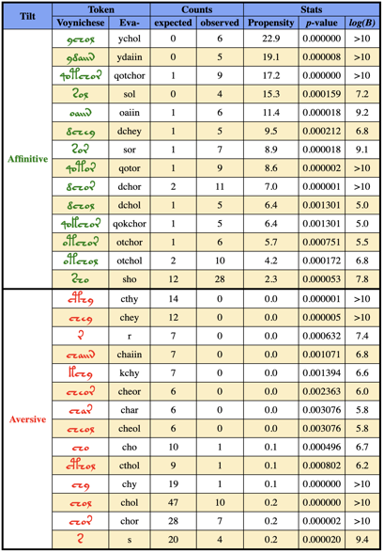
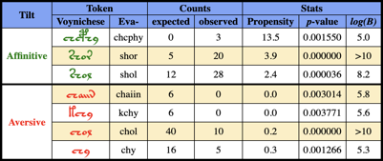
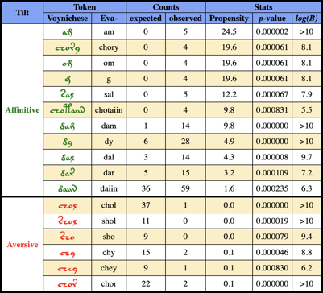
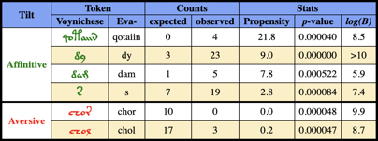
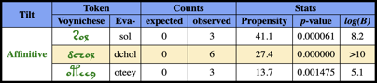
Catalog of Tilted Propensity Tokens
FIRST
TOP
LAST
BEFORE
AFTER
Notes:
The complete catalog of tokens, along with their statistical test metrics is included in the Supplemental Online Material

Slide 32
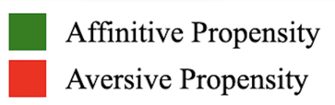
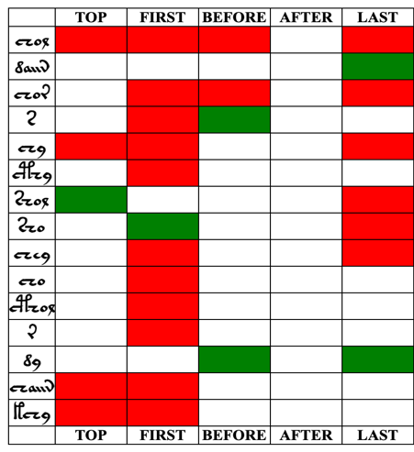
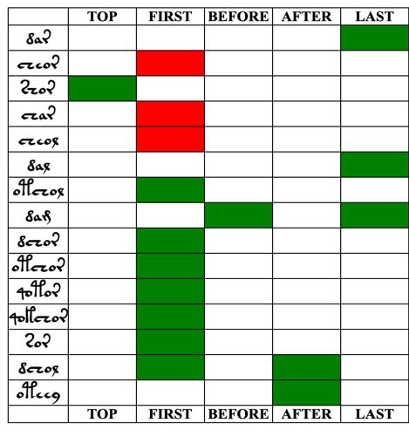
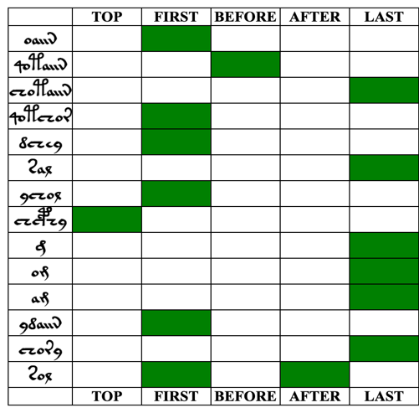
Tilted Token Propensities
Notes:
But this version shows the catalog without the details of the statistical quantities.
All of the tokens that showed a tilted propensity are here, and each column shows what tilt was for each of the subject cohorts
The green indicates a positive tilt or affinitive propensity – that is the scribe seems to show a propensity to use that token in a particular position more often than in the middle of paragraphs
And the red shows a negative tile or aversive propensity – so the scribe shows a propensity to avoid using that token in the particular position

Slide 33
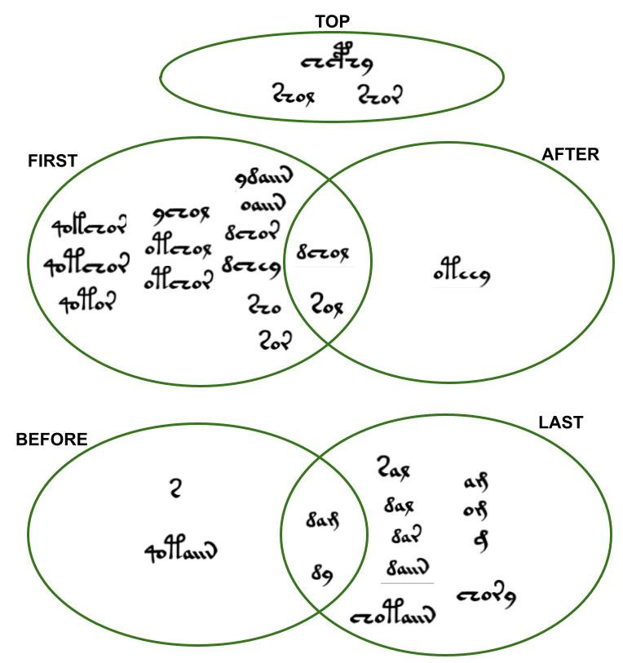
Tilted Token Propensities
The tilted propensity tokens fall into three distinct groups
Notes:
This diagram shows another aspect that is not obvious in the previous table
For the tokens with affinitive propensities, there are three distinct groups.
The are are tokens that show an affinity for the top line in a paragraph but they show no affinity for the other positions
And a separate set of tokens that show an affinity for the position at the start of a line or immediately after a drawing or both
And there is a third set of tokens that show an affinity for positions at the end of a line or immediately before a drawing or both
I don’t want to speculate too much, but this suggests that the first token in a line and the first token immediately after a drawing form the left-hand end of some functional pattern, while the last token in a line and last token immediately before a drawing form the right-hand terminal of that pattern.

Slide 34
Conclusions

Slide 35
Conclusions
1. Tokens immediately preceding the intrusion of a drawing
⇒shorter than tokens located elsewhere.
2. Tokens in the top lines of paragraphs, at the beginnings of lines, and immediately following a drawing intrusion
⇒tend to be longer.
3. Certain tokens have significant propensities to be either used or avoided by the scribe, depending on position.
4. Tokens exhibit positional propensity not only for positions dependent on the script itself, but for positions dependent on the drawings, which are extrinsic to the script.
Notes:
There are several specific conclusions listed in the paper but…

Slide 36
Noteworthy Conclusion
The distributions of the unique Voynichese tokens depend not only on their position within paragraphs and lines, but also on their position in relation to features that we expect would be extrinsic to syntax, namely the boundaries imposed by the presence of drawings.
Notes:
The most noteworthy conclusion is …

Slide 37
Possible Explanations

Slide 38
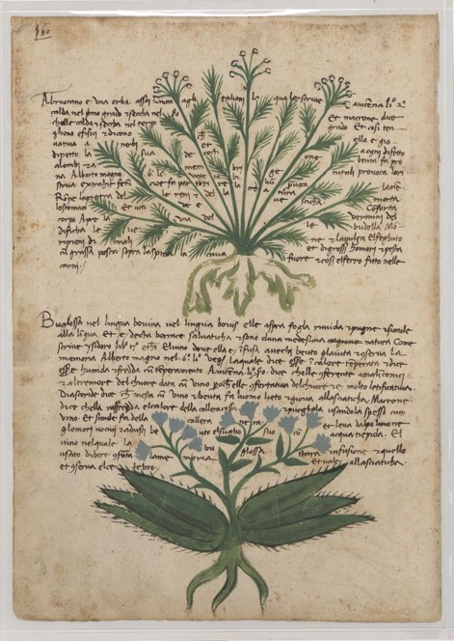

Abbrevs. / Split Words?
Similar Script forms sometimes found in late medieval herbal codexes
Trinity O.2.48 (192r)
Italian Herbal Circa 1500, University of Vermont
Notes:
It’s worth showing some data related to possible explanations for the token propensities related to the drawings.
The Voynich manuscript is not unique in having script that is written sround and between drawings of plants
Here are two such examples.
In those cases the words adjacent to the drawings are sometimes abbreviations or words that are split across the drawings.
The highlighted word here is the Italian word “decocitone” split into three sometimes abbreviations
For instance, in line 6 of the Vermont herbal you can see the old Italian word "decoctione" split into "de cocti one".
https://mss-cat.trin.cam.ac.uk/manuscripts/uv/view.php?n=O.2.48
And
Italian Herbal Circa 1500,
University of Vermont

Slide 39


Abbreviations / Shorthand?
Results seem inconsistent with this explanation
Does not explain aversive tokens that are relatively short
Does not explain why there are tilted propensity tokens following drawing intrusions
At least one strongly affinitive token is relatively long
BEFORE
AFTER
Notes:
So could the Voynichese propensities just be abbreviations or shorthand?
The results seem inconsistent with this explanation.
It doesn’t explain why some tokens that are relatively short are avoided before drawings
Doesn’t explain the tilted propensities seen after drawings
And at least one of the affinitive tokens before drawings is relatively long

Slide 40

Split Words
The potential token parts occur much more frequently elsewhere as individual “words” than as joined ones
Notes:
What about the splitting of words
One way to look into this, is to look at whether the tokens before and after a drawing occurs as a single word elsewhere more often than do the individual tokens
Actually the individual tokens generally occur much more frequently than the joined pair do.
But this is an imperfect analysis – it doesn’t provide very strong evidence against the tokens being cases of split words

Slide 41

Testing for Split-Words
Splitting of words across the drawing intrusions
Consider each token to be the potential lead-portion of a word
(Or trail-portion for tokens after drawing intrusions)
Notes:
A better way to test the idea is to simply redo our analysis but consider each token seen before a drawing to be either a single token or just the leading portion of a word
(or the trailing portion, in the case of tokens following a drawing.)

Slide 42














Compare to Split-Word Assumption
BEFORE
Token Before or as Prefix
Split-Word Assumption
Whole-Word Assumption
AFTER
Token After or as Suffix
Notes:
When we do that, our overall results do not change significantly
We still find that there are several tokens with tilted propensities and most of them are the same tokens as from th4
We lose two in the BEFORE positions
And we pick up two and lose one in the AFTER positions.
Six of the tokens remain the same.

Slide 43
Summary

Slide 44
Summary
The evidence for the more obvious explanations for the extrinsic propensities is weak
Longer tokens
START of lines
And
AFTER drawings
Token lengths show some tendencies related to position
Longer tokens
TOP of paragraphs
Shorter tokens at
BEFORE drawings
and at
END of lines
⇒ Not just shorthand
⇒ Not just word splitting
Certain tokens have affinitive or aversive propensity for positions that are intrinsic to the script
TOP of paragraphs
START of lines
END of lines
There is some correlation of tilted propensity tokens between positions
Certain tokens have affinitive or aversive propensity for positions that are extrinsic to the script
Negative correlation
between
TOP
and
START/AFTER
and
BEFORE/END
BEFORE drawings
AFTER drawings
Positive correlation
between
START and AFTER
Positive correlation
between
BEFORE and END

Slide 45
Extra Slides

Slide 46

Basic Cohort Statistics
Notes:
This gave us several different cohorts to analyze –
a reference cohort being the MIDDLE set
Five primary subject cohorts which are all mutually exclusive
And several validation cohorts that were subsets of the reference cohort

Slide 47

One-Tailed Binomial Test:
Observed vs Expected Counts

Slide 48

Bayes Factor:
Comparative Strength of Evidence

Slide 49
Bonferonni type corrections
Bonferonni type corrections apply to single hypothesis being tested repeatedly (on the same data set)
But we are testing many independent hypotheses, on the data (which happens to be shared across tests)

Slide 50
Prevalence vs Propensity
Prevalence vs Propensity
-examples using Voynich research
-Prevalence approaches consider the single case of VMS and then seek the probability of (observer) finding X
-Propensity considers what one “expects” and and compares it with what one “observes” and thereby finds the probability of (author) producing X

